Slide 1
Personal Increasing Returns:
Analytics and Applications
A new chapter from the next edition of
Chicago Price Theory
Fall 2023

Slide 2

Purpose
Identify common analytical features of human investment and consumption choice problems with falling marginal cost
Show shared results, some surprising
in a supply-demand framework
$\max_{h,q}{u\left(y−p\left(h\right)q−h,q\right)}$
q = consumption of good/service of interest
p(h) = price of q. $p^{′}\left(h\right)<0,p^{′′}\left(h\right)>0$
h = q-independent (“nonrival”) cost of reducing p
y = income

Slide 3
Examples
Volume discounts on consumer services
  Train pass/gym membership/supper club/frequent flier/record club
Nonmedical opioid use
  Own Rx vs secondary market vs heroin vs fentanyl …
Alcohol consumption
Automobiles: choice of model determines cost per mile
Joint determination of human capital and labor supply
Consumer finance
  Pay fixed cost to access/learn about higher return savings vehicles
  Pay fixed cost to consolidate high-interest consumer loans

Slide 4
Examples
Volume discounts on consumer services
  Train pass/gym membership/supper club/frequent flier/record club
Nonmedical opioid use
  Own Rx vs secondary market vs heroin vs fentanyl …
Alcohol consumption
Automobiles: choice of model determines cost per mile
Joint determination of human capital and labor supply
Consumer finance
  Pay fixed cost to access/learn about higher return savings vehicles
  Pay fixed cost to consolidate high-interest consumer loans

Slide 5

Two-stage solution
Stage 1: Produce q at minimum total cost
$$E\left(q\right)≡\min_{h≥0}\left\{h+qp\left(h\right)\right\}$$
h(q) = cost minimizing investment
Hicksian properties
$E^{′}\left(q\right)=p\left(h\left(q\right)\right)>0, E^{′′}\left(q\right)=p^{′}\left(h\left(q\right)\right)h^{′}\left(q\right)≤0$
Stage 2: Allocate income between q and other goods
$$\max_{q≥0}{u\left(y−E\left(q\right),q\right)}$$

Slide 6



Figure 1. Personal increasing returns in the commodity space; consumer version
All other goods
$$y$$
LEGEND
Budget constraint
Investment cost at allocation A
$$qp\left(h\left(q\right)\right)$$
A
$$y−E(q)$$
Quantity (q)
0

Slide 7
Figure 1b. Personal increasing returns
Opioid application
All other goods
$$y$$
LEGEND
Budget constraint
heroin fixed cost
fentanyl additional fixed cost
Linear pieces →
(i) constant effect is not a good model, (ii) offer a metric of the amount of increasing returns
fentanyl
fentanyl+tranquilizer
Rx
heroin
MGEs of Opioids
0

Slide 8

Figure 1c. Personal increasing returns
Vehicle choice
All other goods
$$y$$
LEGEND
Budget constraint
Cost of 1st addition to vehicle’s MPG
Added vehicle cost of 2nd MPG upgrade
Miles
driven
0

Slide 9
Figure 1c. Personal increasing returns
Vehicle choice
All other goods
$$y$$
LEGEND
Budget constraint
Indifference curve
Miles driven
0

Slide 10



Figure 1d. Personal increasing returns in the commodity space; intertemporal version
Current consumption
LEGEND
Budget constraint
y₁
$$E\left(q\right)≡\min_{h≥0}\left\{h+qp\left(h\right)\right\}$$
$$E\left(q\right)≡\min_{h≥0}\left\{h+\left(q−y_{2}\right)p\left(h\right)\right\}$$
h = cost of accessing high returns
$$y_{1}−E(q)$$
A
Future consumption (q)
0
y₂

Slide 11


Labor Supply and Human Capital
Leisure
$$1$$
LEGEND
Investment cost
No investment
Investment
Indifference curve
B
C
$$consumption$$
0

Slide 12

Figure 1e. Personal increasing returns human capital version
All other goods
LEGEND
Budget constraint
Investment cost at allocation A
$$E\left(q\right)≡\min_{h≥0}\left\{h+qp\left(h\right)\right\}>0$$
$$E\left(q\right)≡\min_{h≥0}\left\{h+\left(q−1\right)p\left(h\right)\right\}<0$$
A
$$y−E(q)$$
y
h/p(h)
Leisure (q)
0
$$1$$

Slide 13
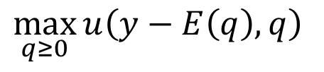
Figure 1. Personal increasing returns unique optimum
All other goods
$$y$$
LEGEND
Budget constraint
Indifference curve
$$\max_{q≥0}{u\left(y−E\left(q\right),q\right)}$$
A
Quantity
0

Slide 14
Figure 1. Personal increasing returns
Allocations A and C are on the same indifference curve, and dominate B
All other goods
$$y$$
LEGEND
Budget constraint
Indifference curve
C
B
$$\max_{q≥0}{u\left(y−E\left(q\right),q\right)}$$
A
Quantity
0

Slide 15
Degrees of complementarity
Complementary inputs
Falling marginal cost
MC intersects MB multiple times

Slide 16


Relaxing the non-rival assumption
What if the marginal cost of h is g(q) > 0 rather than 1?
  $g^{′}\left(q\right)>0$
If g(q) is strictly concave, then E(q) is strictly concave too
  Same multiplier analytics
  Same analytics of multiple solutions
$$E\left(q\right)≡\min_{h≥0}\left\{g\left(q\right)h+qp\left(h\right)\right\}$$

Slide 17

“Demand” = “Supply”
First-order condition describing q:
$$M\left(y−E\left(q\right),q\right)=E^{′}\left(q\right)$$
M = MRS function
  Quasi-concave u: M slopes down in q
  If q is either normal or inferior, M is not the inverse of Hicksian demand (from u), although the two demand curves intersect each other and are tangent at the optimal q
“Supply” $E^{′}\left(q\right)$also slopes down
Let $1/ε_{d}<0$ and $1/ε_{s}<0$, respectively, denote the point elasticities.

Slide 18

Figure 1b. Two demand concepts
All other goods
MRS
$$y$$
Hicksian demand
MRS function
LEGEND
Budget constraint
Indifference curve
A
q₁
q₃
q₂
q₂
q₃
0
q_{A}
Quantity
q₁
q_{A}
Quantity

Slide 19
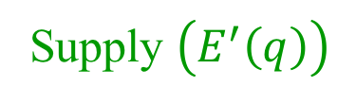


Figure 2. Personal increasing returns in quantity-price space
Marginal
Price
$$p(0)$$
A
Supply $\left(E^{′}\left(q\right)\right)$
$$p(y)$$
Demand (M)
Quantity
0

Slide 20

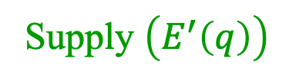




Figure 2b. Problem Set 6 in quantity-price space
Marginal
Price
$$M\left(y−E\left(q\right),q\right)+m=E^{′}\left(q\right)$$
$$dm>0$$
$$dx>0$$
$$E^{′}(0)$$
A
Supply $\left(E^{′}\left(q\right)\right)$
$$da>0$$
Demand (M)
Miles driven
0

Slide 21


Figure 2. Personal increasing returns in quantity-price space
Marginal
Price
$$p(0)$$
2020 w/ horizontal supply
2019
2020
Supply
$$p(y)$$
2019 Demand
Quantity
0

Slide 22

Predictions
Quantity and MC cannot change in the same direction without both curves shifting
  Even in that case, the alternative requires restrictions on both the directions and amounts of the shifts
  Demand shifts easily confused with supply shifts
Demand shifts are “multiplied”
$$d\ln{q}=−ε_{d}\frac{−ε_{s}}{ε_{d}−ε_{s}}\frac{dm}{p}>−ε_{d}\frac{dm}{p}>0$$
The multiplier is not constant, because $ε_{s}$ is not constant.

Slide 23
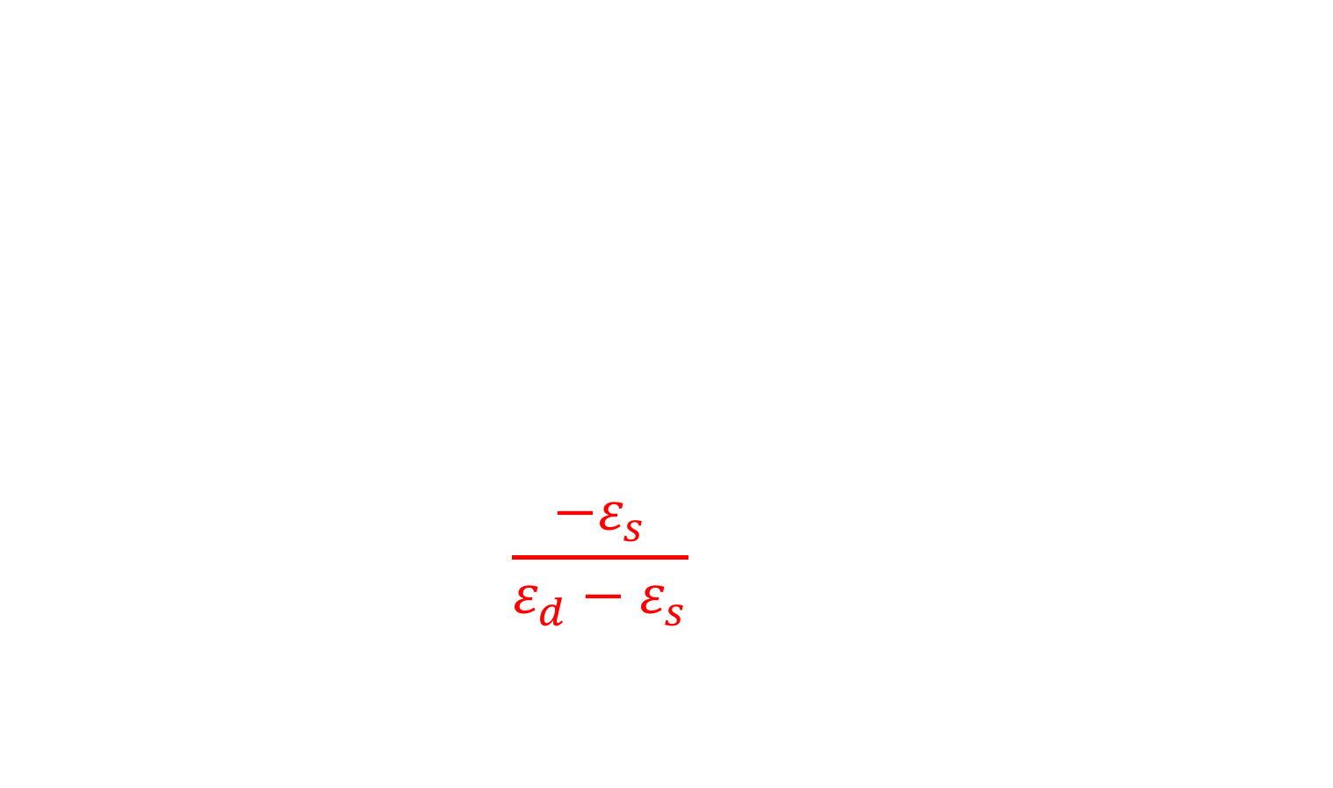
Predictions
Quantity and MC cannot change in the same direction without both curves shifting
  Even in that case, the alternative requires restrictions on both the directions and amounts of the shifts
  Demand shifts easily confused with supply shifts
Demand shifts are “multiplied”
$$d\ln{q}=−ε_{d}\frac{−ε_{s}}{ε_{d}−ε_{s}}\frac{dm}{p}>−ε_{d}\frac{dm}{p}>0$$
The multiplier is not constant, because $ε_{s}$ is not constant.

Slide 24
Table 1. Quantity-change amplification in the personal increasing returns model
ε_{s}/ε_{d} | ε_{s}/(ε_{s} −ε_{d})
1 | ∞
1.25 | 5
1.5 | 3
2 | 2
5 | 1.25
∞ | 1
Note: ε_{d} and ε_{s} are the price elasticities of demand and supply, respectively, with ε_{s} < ε_{d} < 0. This formula applies to local comparative statics.

Slide 25
Figure 3. Female Participation in Professional Schools

Slide 26
Substitution Behavior in the “Wrong” direction
Take the case where supply and demand cross more than once
Raising the price of q at the low-investment point can induce a switch to the high-investment (and high consumption) point
  Even if the price of q increases everywhere
  Without the increasing-returns perspective, this might appear as a violation of the law of demand
  In fact, it is a movement down a single Hicksian demand for q

Slide 27




Figure 4. Personal increasing returns
Allocations A and C are on the same indifference curve, and dominate B
Marginal
Price
Absent income effects, compare areas of “football” CB and football BA
$$p(0)$$
$$p\left(h_{C}\right)$$
C
B
A
Supply $\left(E^{′}\left(q\right)\right)$
$$p\left(h_{A}\right)$$
$$p(y)$$
Demand (M)
Quantity
0
Local optima A and C are compared based on the area to the left of the Hicksian demand curve (not shown, but closely related to M as discussed in the text) and the additional investment $h_{A}−h_{C}$ required to obtain the lower price.

Slide 28
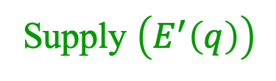


Figure 4. Personal increasing returns
Allocations A and C are on the same indifference curve, and dominate B
Marginal
Price
MRS function (M)
Hicksian demand curves
$$p\left(h_{C}\right)$$
C
B
A
Supply $\left(E^{′}\left(q\right)\right)$
$$p\left(h_{A}\right)$$
Quantity
0

Slide 29

Consumption responses when heroin prices are low
All other goods
LEGEND
Rx
C = before 2010
A = after 2010
Heroin
Indifference curve
C
A
$$q_{opioids}$$
0
Stricter Rx-opioid regulation

Slide 30
Conclusions
A broad range of activities exhibit increasing returns at the personal level. A.k.a., endogenous specialization
Tractable (single-equation) analysis is still possible
  Behavioral multiplier
  Supply and demand factors are surprisingly similar
Constant-effects model is often misleading
Substitution effects may appear to go in the “wrong” direction

